Slide 1
The Financial Impact of Patient
Relationships With Orlando Health
SEPTEMBER 2022 l CHRIS MALONE, FIDELUM PARTNERS l KEN KOZIELSKI, FORMERLY ORLANDO HEALTH

Slide 2


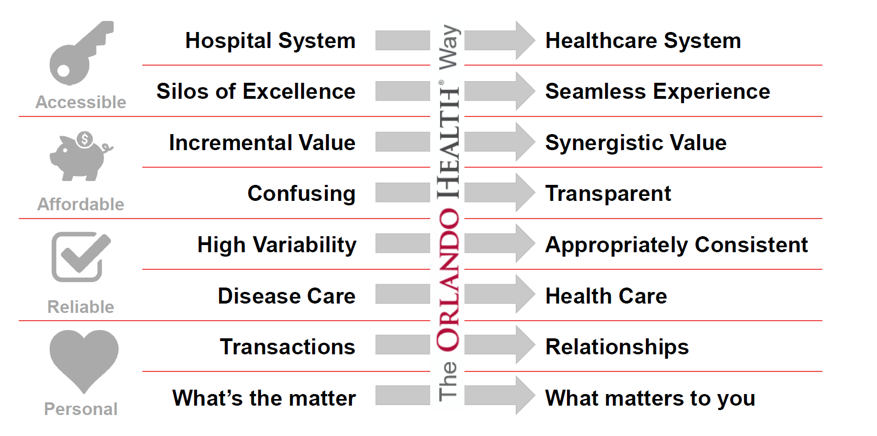
The Orlando Health Way Case Example
Orlando Health is a not-for-profit 3,200-bed system that includes 16 wholly-owned hospitals and emergency departments, rehabilitation services, cancer and heart institutes, imaging and laboratory services, physician offices, skilled nursing facilities, home healthcare and urgent care centers.
SOUGHT TO TRANSFORM FROM
TO

Slide 3

Patients Want to Feel Cared About
Patients who trust Orlando Health not only feel their care givers are ABLE to get them well. They believe their care givers’ INTENTIONS are focused on the unique needs of the patient.
The Orlando Health Way is
caring for you and about you.
Our Ability
Our
Intent
Assure
Engage
Unite
Remove Fear
Build Lifelong Relationships
Work as One Team

Slide 4
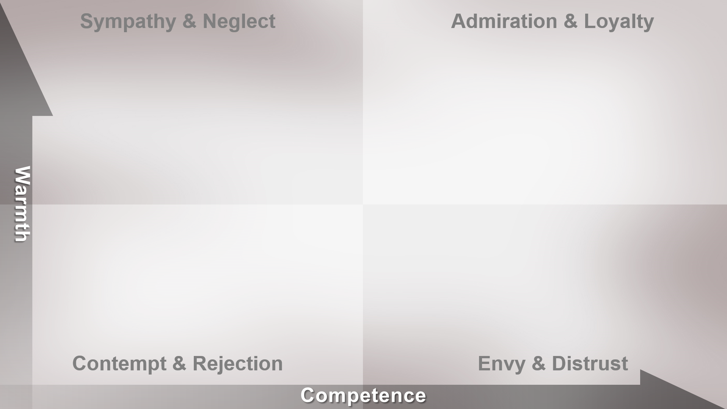




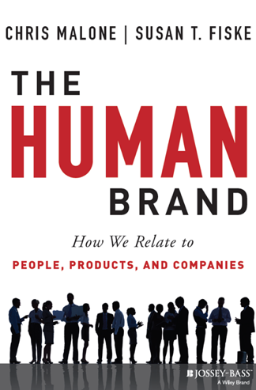






Brands as Intentional Agents Framework Applied
In collaboration with Princeton social psychologist, Dr. Susan Fiske, our team researched and validated that the warmth and competence social perception process also guides human behavior in commerce.
Our first paper (from this CBR conference) was published in 2012 and in an award winning book in 2013, and has since received over 600 academic citations.
Elderly
Professionals
Poor
Wealthy

Slide 5

Patient Relationship Research Overview
Kick-Off Work Session & Project Charter
  Review the work plan and gain team alignment on the role, stakeholders, scope and desired outcomes for this project.
Discovery Interviews & Insights Review
  Interviews with key stakeholders and review of existing insights to understand current patient experience hypotheses, touchpoints and feedback processes.
Patient Segmentation & Relationship Impact Research
  HUMAN Brand experience assessment and segmentation with at least 2,500 patients to identify distinct groups with differing priorities, perceptions and loyalty to Orlando Health.
Summary of Patient Segmentation & Relationship Impact Findings
  A comprehensive report of patient segmentation profiles and experience attributes that most strongly impact relationships with Orlando Health.

Slide 6
Patient Relationship Research Methodology
Experience and relationship feedback was captured online from 3,086 recent Orlando Health patients between June 10 – July 15, 2019, using email invitations and a prize drawing incentive.
  This feedback was combined with payment and visit data for each patient to enable an in-depth impact analysis of their attitudes, priorities, perceptions and relationships with Orlando Health.
Patient Profile, Payments & Visits
Health-Related Attitudes & Priorities
Orlando Health Perceptions & Loyalty
  Patient type, treatment facility and MedRec #
  Emotions associated with Orlando Health
  Health-related attitudes
  Healthcare provider priorities
  Payments and visits to Orlando Health over past 10 years*
  Patient
  age, gender, education, income, marital status and family size
  Visit types that most impact healthcare provider perceptions
  Loyalty, LTR and overall rating of Orlando Health
  Perceived performance of Orlando Health

Slide 7





The HUMAN Brand™ Insights Model
Commercially, we call this The HUMAN Brand™ insights model and it has been applied to over 150 companies and brands in eight countries and seven languages over the past decade.
One of the objectives of this project was to validate and refine the application of this insights model to the measurement and improvement of patient experiences and relationships.
Warmth
Perceptions
Positive
Emotions
Human
Loyalty
Human
Behavior
Competence
Perceptions

Slide 8

Patient Relationships Require Personalization
Healthcare attitudes, priorities, perceptions and health system loyalty vary significantly across four distinct, attitudinal patient types, so care personalization is needed to strengthen relationships.
Four Distinct Attitudinal Patient Types
Substantially less concerned with their health, engage in riskier lifestyles and are less trusting of healthcare providers and facilities.
Strong relationships and
trust with care providers,
making them enthusiastic
partners in caring for
themselves and their families.
Orlando Health
Relationship Strength: 51%
Visits: 51
Payments: $54.4k
Disengaged Health Riskers
19%
Proactive
Reliants
31%
Orlando Health
Relationship Strength: 79%
Visits: 51
Payments: $45.3K
Orlando Health
Relationship Strength: 77%
Visits: 54
Payments: $49.2K
Proactive in preventing illnesses, sometimes skeptical of care provider advice and unforgiving of poor care experiences.
Genuinely concerned about their health and trusting of care providers, but often find health information and printed materials confusing.
Orlando Health
Relationship Strength: 68%
Visits: 46
Payments: $43.0k:
Uncertain Reliants
25%
Proactive
Skeptics
25%

Slide 9
Drivers of Orlando Health Patient Relationships
Regression analysis of patient responses showed that positive emotions, competence and warmth are the primary drivers of relationships with Orlando Health.
In contrast, demographics, health attitudes and negative emotions have relatively little predictive impact on patient relationships.
Variance in Patient Relationships with Orlando Health Explained
Notes:
9

Slide 10
Impact of Relationships on Payments is Clear
While not a straight line relationship, it’s clear that patients reporting stronger relationships with Orlando Health have also made higher payments in the past 10 years.
In addition, the number of patients reporting very low loyalty is relatively small, so there is likely greater variability in their Orlando Health payment data.
Payments to Orlando Health by Patient Relationship Strength
n=70*
n=44*
n=57*
n=182
n=333
n=524
n=1,169
* Small patient sample size
Notes:
10

Slide 11
Perceptions + Emotions + Loyalty = Financial Impact
Patient Relationships Drive Financial Outcomes
Warmth and competence perceptions drive positive emotions and patient relationships, which have a significant impact on patient behavior and financial outcomes.
+16.4%
+$7,700*
Payments
CURRENT:
+0.80*
AVERAGE:
6.1
1
47K
$
CURRENT:
+0.61*
CURRENT:
Warmth Perceptions
5.8
5.9
Actual Payments to Orlando Health
1
1
Positive
Emotions
Relationship with
Orlando Health
AVERAGE
CURRENT:
+7.2* Visits
+14.3%
50
6.3
+0.36*
VISITS
Competence
Perceptions
Actual Visits to
Orlando Health
¹ Measures rated on 1-7 Scale
* Statistically significant at the 99% confidence interval

Slide 12

Research Conclusions & Implications
These research findings have significant implications for health care providers by offering new insights on how to strengthen patient relationships and financial outcomes.
All healthcare providers in the US are required by the federal government to gather experience feedback from patients as the basis for Medicare reimbursements and quality awards.
The government mandated patient feedback CAHPS surveys (Consumer Assessment of Healthcare Providers & Systems) have not been effective in improving patient experiences.
These insights and methods can complement and improve upon CAHPS patient feedback to strengthen patient relationships and health system effectiveness.
However, further research is needed to validate these findings on a larger scale and in other health systems.

Slide 13

Questions or Feedback?

